Slide 1
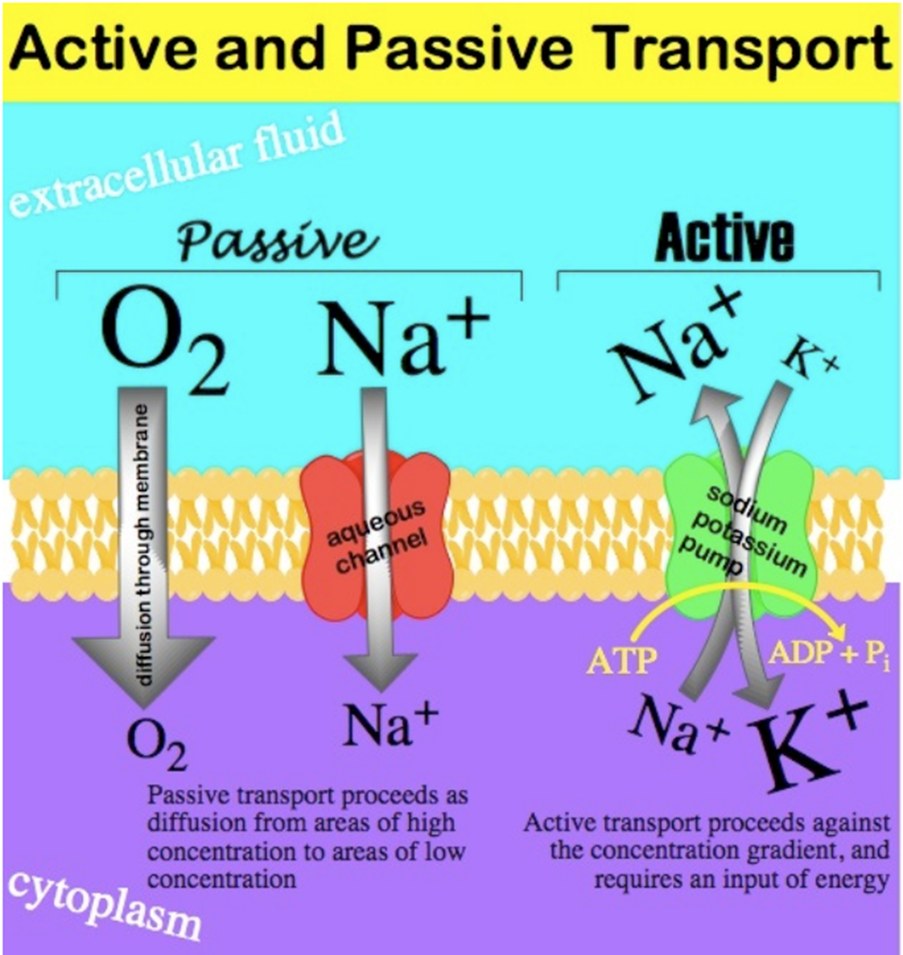
Laboratory 1
Introduction to Visual Basic for Application

Slide 2
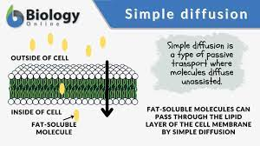
Diffusion Equation
C_{i} is the concentration of the molecule in the cell, moles/liter
C_{o} is the concentration of the molecule outside the cell, moles/liter
k is the diffusion constant, 1/minute

Slide 3
Analytical Solution
C_{i}(t) = concentration inside the cell at time t, moles/liter
t = time, minutes

Slide 4
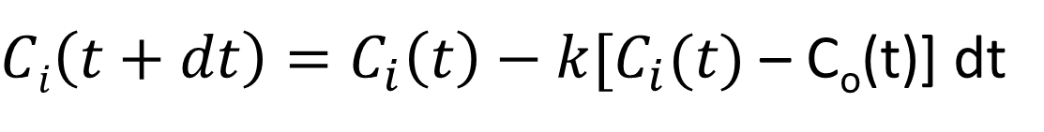
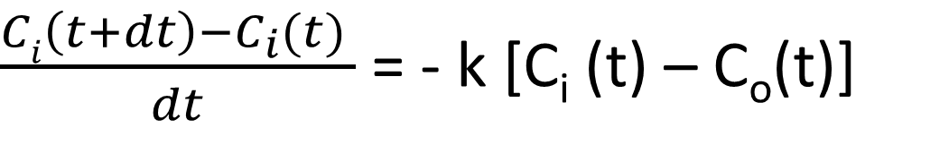
Numerical Solution
$\frac{Ci\left(t+dt\right)−C_{i}(t) }{dt}$ = - k [C_{i} (t) – C_{o}(t)]
$Ci\left(t+dt\right)=C_{i}\left(t\right)−k[C_{i}(t)$ – C_{o}(t)] dt
Pick a time step, Δt
Set initial value for C_{i} at time t=0 (initial condition)
Compute C_{i} for each time step, beginning at 0+Δt

Slide 5
Activate VBA and Macros in Excel
Turn on VBA
Select Files/Options/Customize Ribbon/ in Excel
Activate VBA
Allow Macros
Select Files/Options/Trust Center/ in Excel
Click on the Trust Center Settings button
Enable all macros
Check Trust access to the VBA project object module
Excel files will now have a *.xlsm (macro enabled) extension

